Slide 1


50 BEDED UPAZILA HEALTH COMPLEX
Chowgacha, Jessore.

Slide 2





CHOWGACHA UHC-Through the Ages
Old UHC
Old UHC
31-bedded UHC
50-bedded UHC

Slide 3
A Hospital with a Vision …
Maximum utilization of Govt.
resources with
honesty and sincerity.
Integrated approach of
Administration, Community
Leaders .
Providing Effective services
through improved
management system.

Slide 4
Background History of MCH services of Chowgacha Health Complex, Jessore
To reduce Maternal and Child Mortality and Mobility and to ensure the quality services to the mother and child, UHFPO opened 4 special activities headed by medical officers in Feb. 1996. And from January 1995 to 1997 JICA helped us by Frontline MCH Program to implement the program by giving technical and logistic supports. Since 1998 DGHS & UNICEF have continued the support.
<4 Special activities>
ANC-Corner
Basic EOC service
Under 5 corner for under 5 children
Monthly birth and death record

Slide 5
Background History Contd.
Dec. 1999 – DGHS & UNICEF provides logistic & Anaesthesia Trg.
November 2000 started Comprehensive EOC program
2004—2014 - the UHC was awarded by the Bangladesh Government and UNICEF for best performance on EOC Service.
August 2006-Safe Blood Transfusion unit established with the aid of UNICEF.
April 2007-Demand Side Financing (DSF) program started.
Women friendly Hospital declared in 2008.
Hospital declared as model health complex on 20 June 2008 and upgraded to 50 bedded hospital by Secretary of Ministry of Health & family welfare.
“Chowgacha health complex Model is replicable through out the country” Declared by Dr. Margaret Chan, D.G. WHO on 8th March 2010.

Slide 6
Reason why Chowgacha Health Complex is Model-1
Successful leadership in health management
All the Components of Primary Health Care are successfully implemented here
Personal and group skills in health care
Community engaged health management
Optimum use of government resources
Effective relation with local administration and with other government organizations
Improvement of security by community engagement
Improved maternal health care activities
Improved child health care activities
Ensuring corner-based health care
Woman and Baby Friendly Hospital
Display of Protocol Board and Citizen Charter

Slide 7
Reason why Chowgacha Health Complex is Model-2
Birth and death recording, progress assessment and accountability by collecting information on all health indicators
Improving healthcare by unit management
Health awareness by health education in outdoor, indoor, ante-natal registration room and pregnant women restroom
Cleanliness (Waste management) and beautification of the facility and premises
Provision of safe blood transfusion for emergency needs
Zero tolerance against corruption
Implementation of the 5S KAIZEN-TQM for the improvement of health care
Improved financial management by establishing cash counter

Slide 8
Health Profile of Chowgacha Upazila- 2020
Total Population : 2,66,613
Total Fertile Couples : 52,787
Total Pregnant : 5,089
Total Delivery : 4,626
Total Live birth : 4,586
Total death : 1,135
Health Man power
a. Doctor : 22(Consultant-03, M.O-19)
b. Nurse : 25
c. HA : 21
d. SBA : 16( 4HA+8 FWA+4CHCP )
e. Volunteer, Security guard & cleaner : 34
Health Institutions
a. Health Complex : 01
b. H & FWC : 11 (RD- 4 + FWC– 7 )
c. Community clinic : 27(26+1)
d. Non- Govt. Clinic : 06

Slide 9
Health Profile of Chowgacha Upazila- 2020
Mother Taken-ANC 1st : 6995 (140.6%)
Total Hospital Delivery : 2615 (52.54 %)
Total C. Section rate : 795 (30.40%)
No. of Hospital bed : 50
Bed Occupancy Rate : 112.09 %
CBR : 17.35
CDR : 425.71
CPR : 76.7
Population Growth Rate : 1.30 %
Maternal Mortality Ratio : 109.02 / 100000 live births
Neonatal Mortality Rate : 13.30 / 1000 live births
Infant Mortality Rate : 16.13/1000 live births
Under-5 Mortality Rate : 17.88 /1000 live births

Slide 10
Manpower Data of UHC Chowgacha
 | Government Allocated Post | Occupied Post | Vacant Post
First Class Officer | UHC -21 | 11 (52.39% ) | 10 (47.61%))
 | UNION SUBCENTRE-4 | 3 (75%) | 1 (25%)
 | UNION HEALTH & FAMILY PLANNING CENTRE -7 | 7 (100%) | 0
Second Class Staff (SSN + Midwife) | 31 (23 +4) | 25 (80.65%) | 6 (19.35%)
Third Class Staff | 112 | 74 (66.07%) | 38 (33.93%)
Fourth Class Staff | 26 | 12 (46.15%) | 14 (53.65%)

Slide 11
Manpower Data of UHC Chowgacha (cont.)
SACMO | 11
CHCP | 26
HA | 19
AHI | 03
Volunteer | 36 (Hospital : 34 + Field : 02)
MLSS | 01
Skilled Birth Attendant (SBA) | 12 (health: 4 + family planning : 8)

Slide 12
Emergency + Outdoor & Indoor 2011-2020
UHC Chowgacha

Slide 13
Emergency + Outdoor & Indoor 2021
UHC Chowgacha

Slide 14
EOC Activities Chowgacha UHC 2011-2020
EOC Activities : 2011 - 2020(ANC First Visit)

Slide 15
EOC Activities Chowgacha UHC 2021

Slide 16
EOC Activities Chowgacha UHC 2011-2020
EOC Activities : 2011- 2020(ANC Fourth Visit)

Slide 17
EOC Activities : 2011- 2020 (Total Hospital Delivery & C-section )

Slide 18
Total Number of C-Section performed in different hospitals

Slide 19
EOC Activities Chowgacha UHC 2011-2020
PNC Service 2011 - 2020

Slide 20
EOC Activities of UHC Chowgacha 2021

Slide 21
Cervical and Breast Cancer Screening Activities
Year | CBE +ve | CBE –ve | VIA +ve | VIA –ve | Total
2019 | 17 | 4610 | 22 | 4605 | 4627
2020 | 15 | 1334 | 20 | 1329 | 1349
Jan/2021 | 1 | 239 | 0 | 240 | 240
Feb/2021 | 4 | 255 | 2 | 257 | 259
Mar/2021 | 1 | 285 | 2 | 284 | 286
Apr/2021 | 3 | 282 | 0 | 285 | 285

Slide 22
Bed Occupancy Rate (in percentage) of Chowgacha UHC

Slide 23
Bed Occupancy Rate of UHC Chowgacha 2021

Slide 24
Community Clinic Data of Chowgacha Upazila
Total No. of Union- 11
Total No. of Community Clinic – 27
Total Number of Patients –
283019

Slide 25

COVID-19 Response of UHC Chowgacha
COVID-19 Sample Collection
 | NUMBER | COMMENT
Total Specimen Collected | 1341 | Upto 31/05/2021
Total Detected Patient | 213 | Upto 31/05/2021
Death | ০3 | Upto 31/05/2021
Affected Healthcare workers | 27 | Upto 31/05/2021

Slide 26

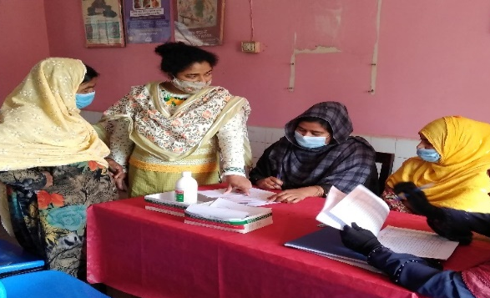
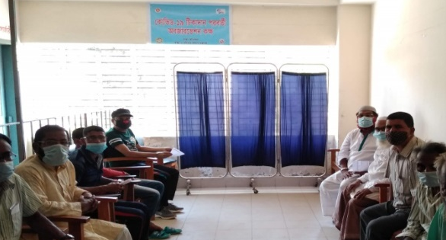
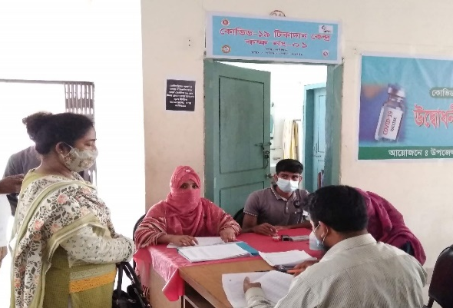
 | Total Number of patients
Total Number of Registration for COVID-19 Vaccination | 7761
1st Dose of COVID-19 vaccine taken | 6572
2nd Dose of COVID-19 vaccine taken | 4359
Vials used for 1st dose | 671
Vials used for 2nd dose | 447
Female Vaccination Corner
COVID-19 Vaccination
Post-vaccination waiting room
Male Vaccination Corner

Slide 27
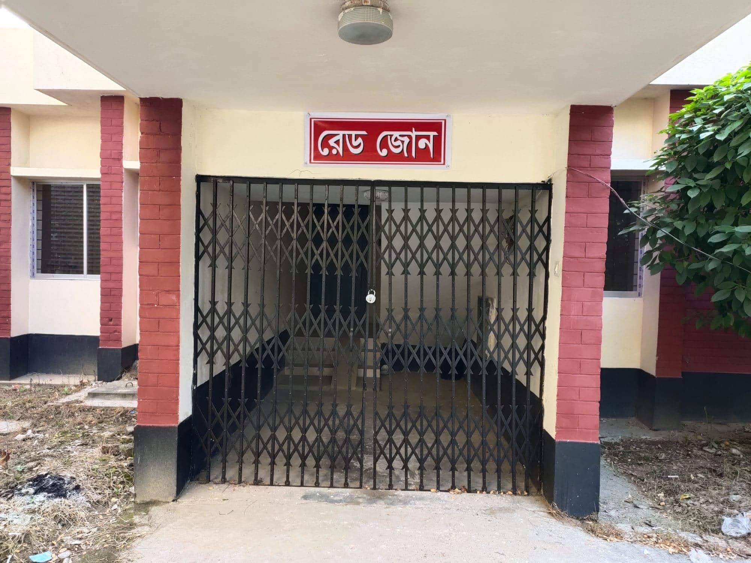
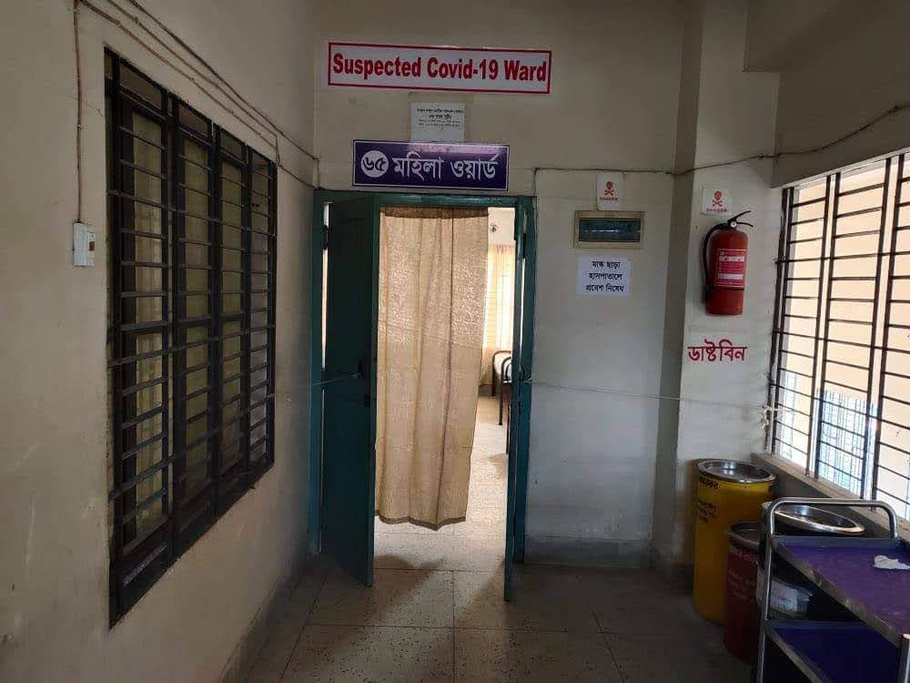
COVID-19 Response of UHC Chowgacha

Slide 28

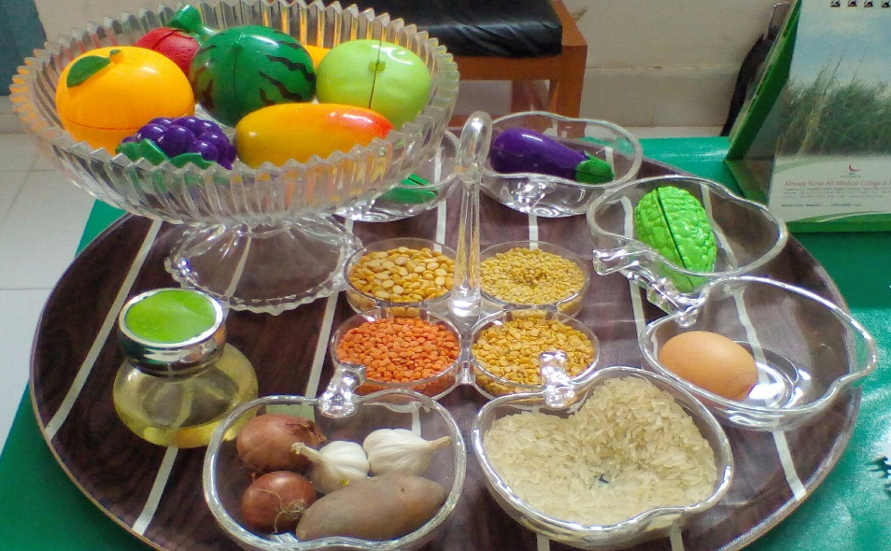
Innovations of Chowgacha Health Complex
Cycle stand near the entrance
“Pushti Tray” – Nutritional Education

Slide 29
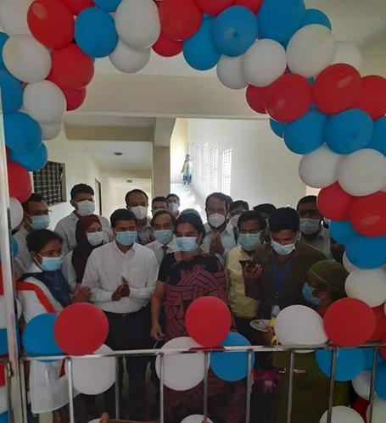
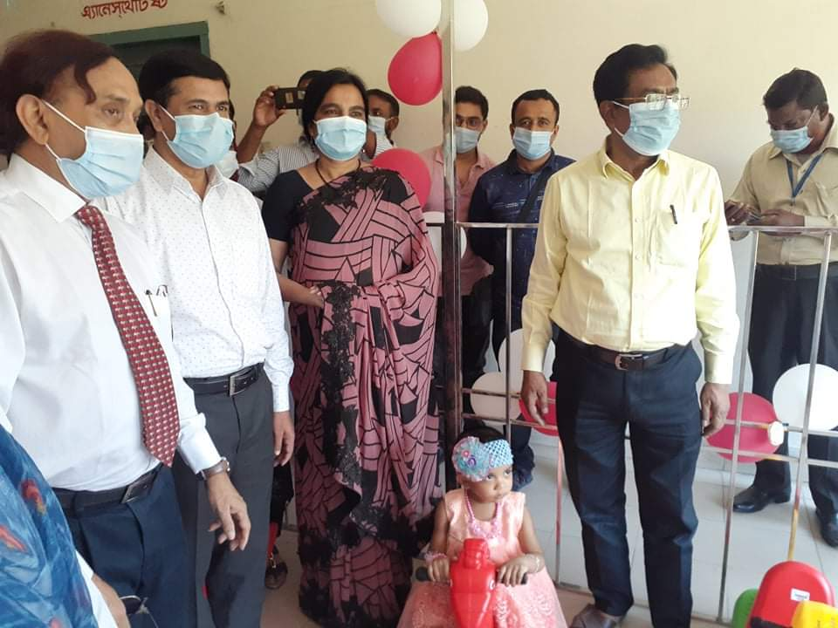
Innovations of Chowgacha Health Complex
Innauguration of Kids’ Corner Professor Dr. Meerjady Sabrina Flora ADG (Planning), DGHS

Slide 30


Innovations of Chowgacha Health Complex
Rest room for pregnant mothers
Cell phone-based Health Service

Slide 31
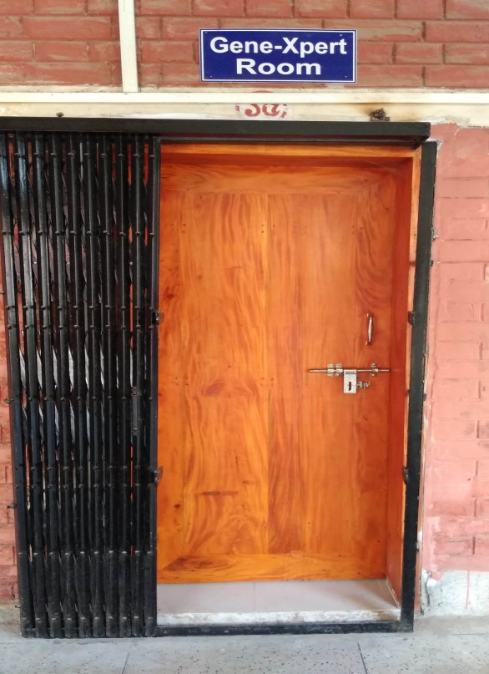
Innovations of UHC Chowgacha
Establishment of Gene X-pert Machine

Slide 32
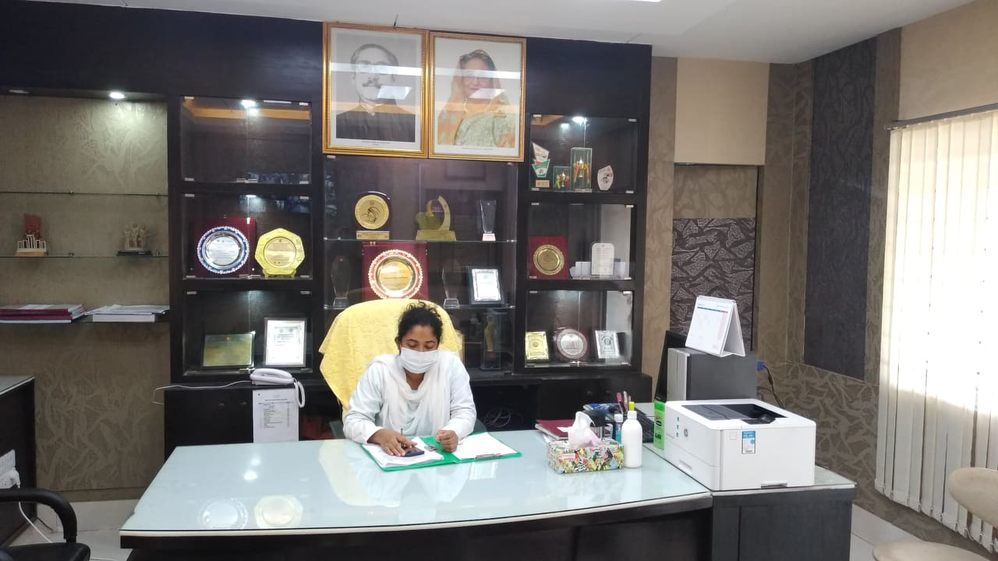
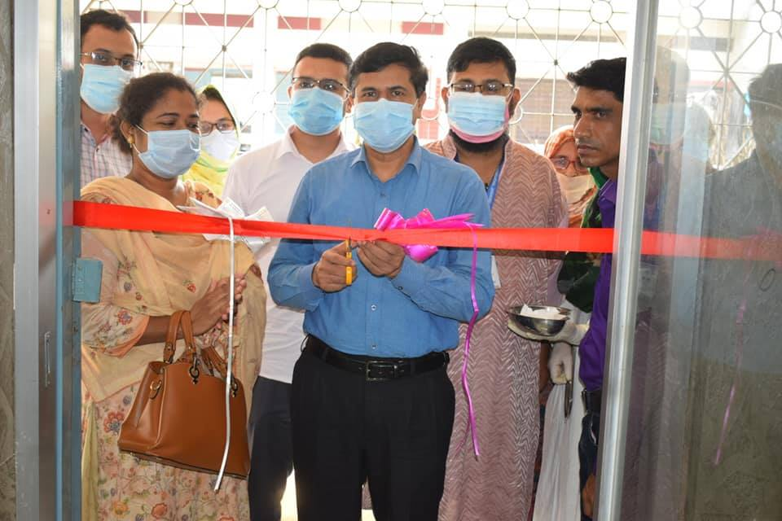
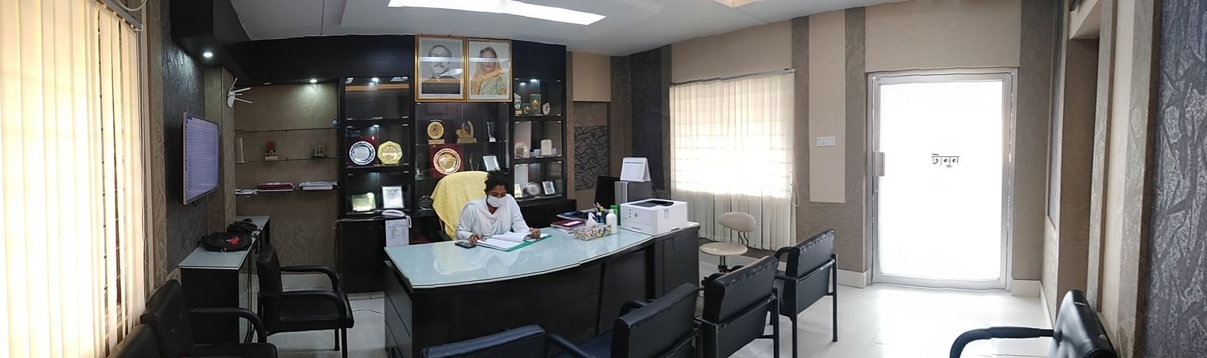
Newly Decorated UHFPO Room

Slide 33
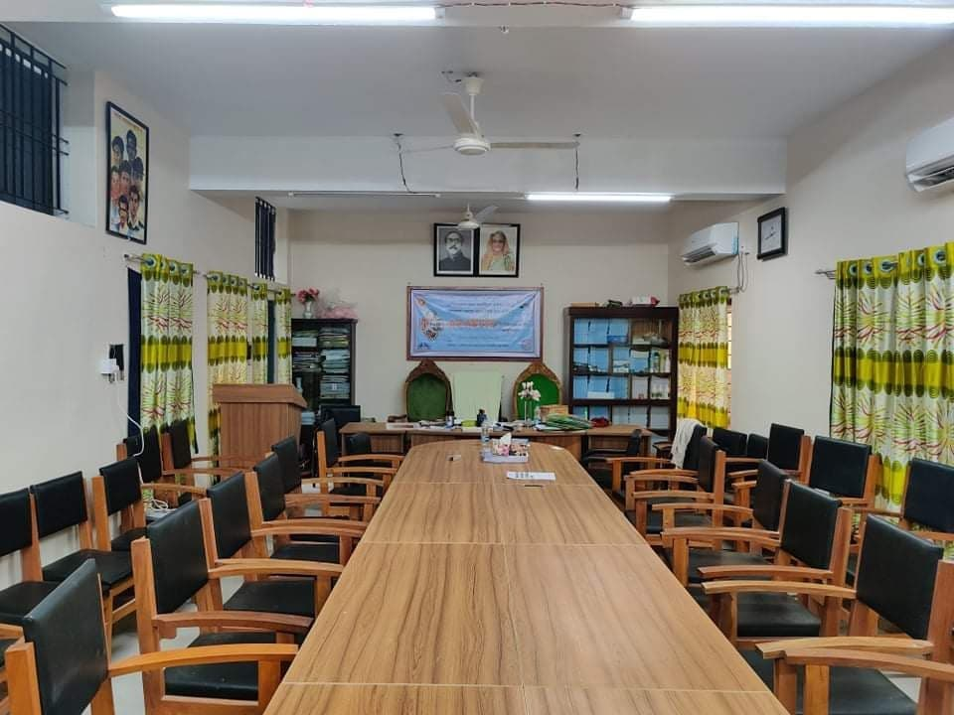
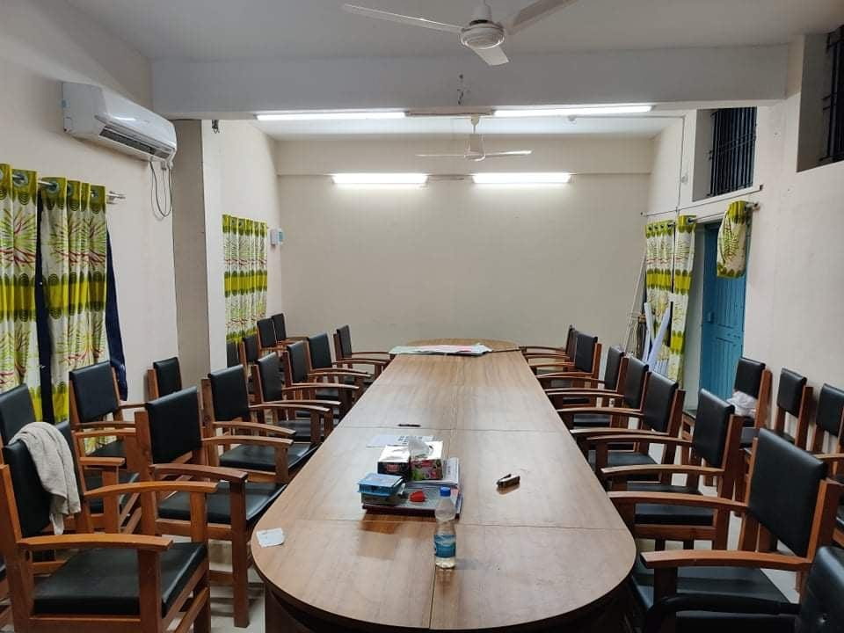
Newly Decorated Conference Room

Slide 34
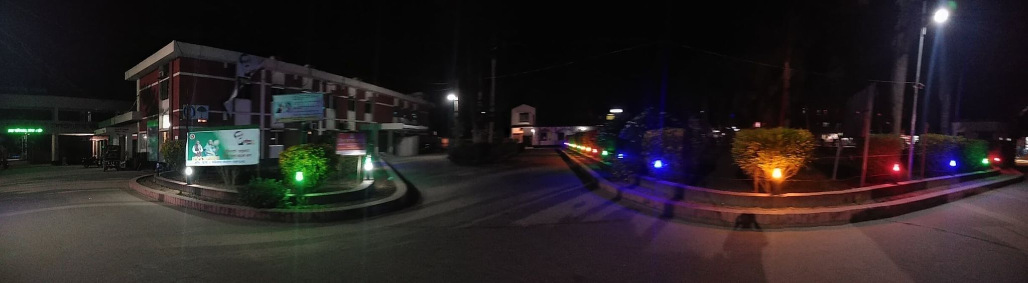
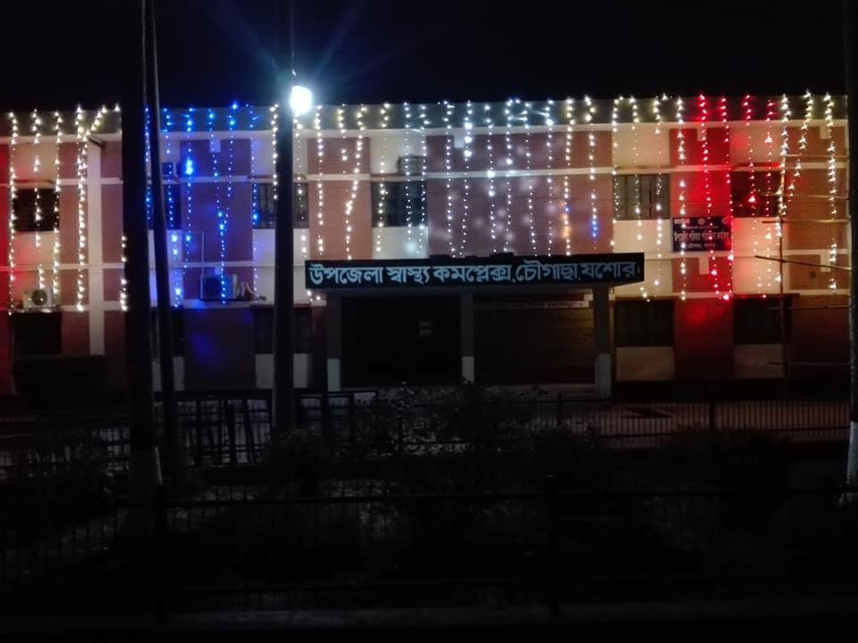
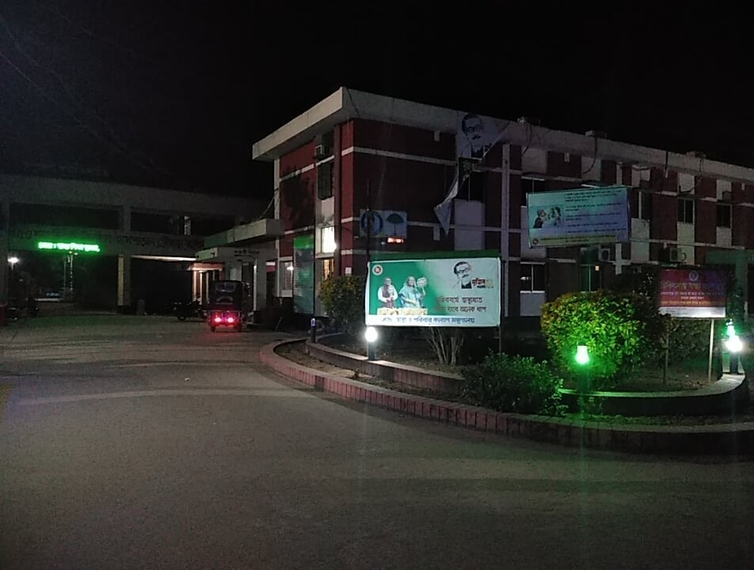
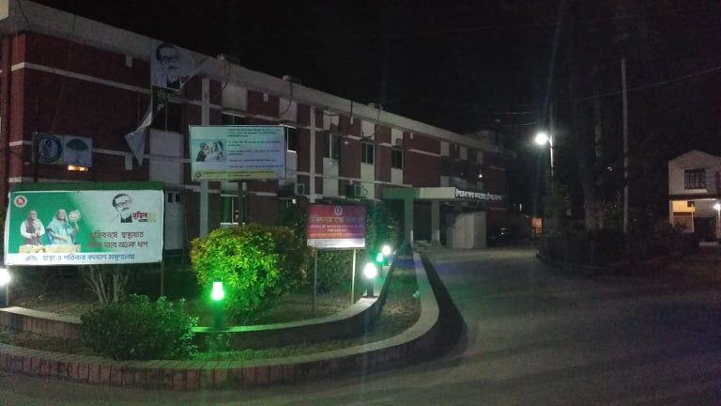
Beautification of the Premises

Slide 35


Daily Activities
Separate line for females
Developed ER with Sterile Workplace

Slide 36


Daily Activities
ANC Corner
IMCI corner

Slide 37


Daily Activities
Breast feeding & EPI Corner
NCD Corner

Slide 38


Daily Activities
Separation of male and female patients in Outdoor
Dispensary with separated male and female

Slide 39

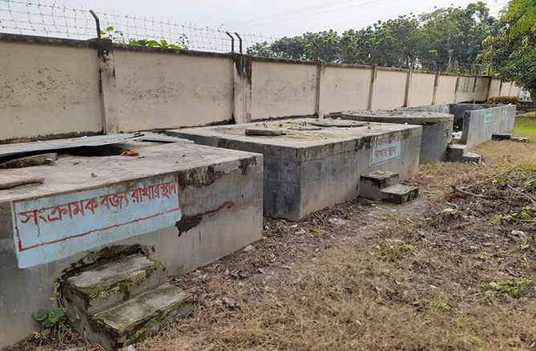
Daily Activities
Labour Ward with 41=(11+30) beds
Developed Waste Management System

Slide 40

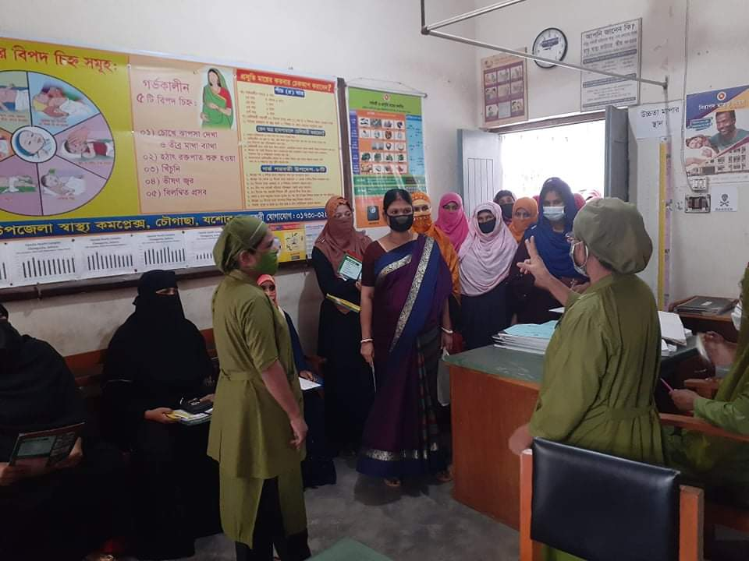
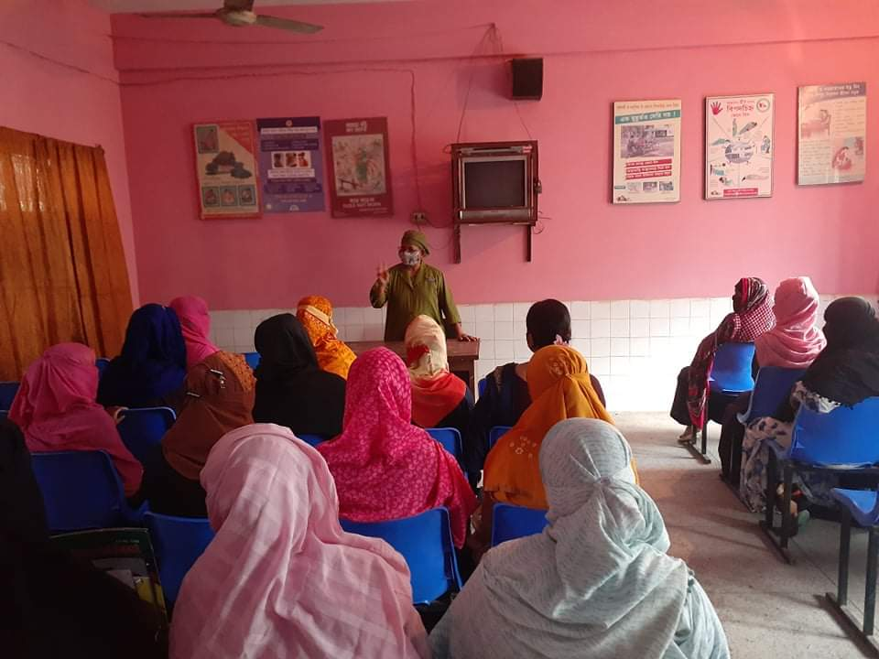
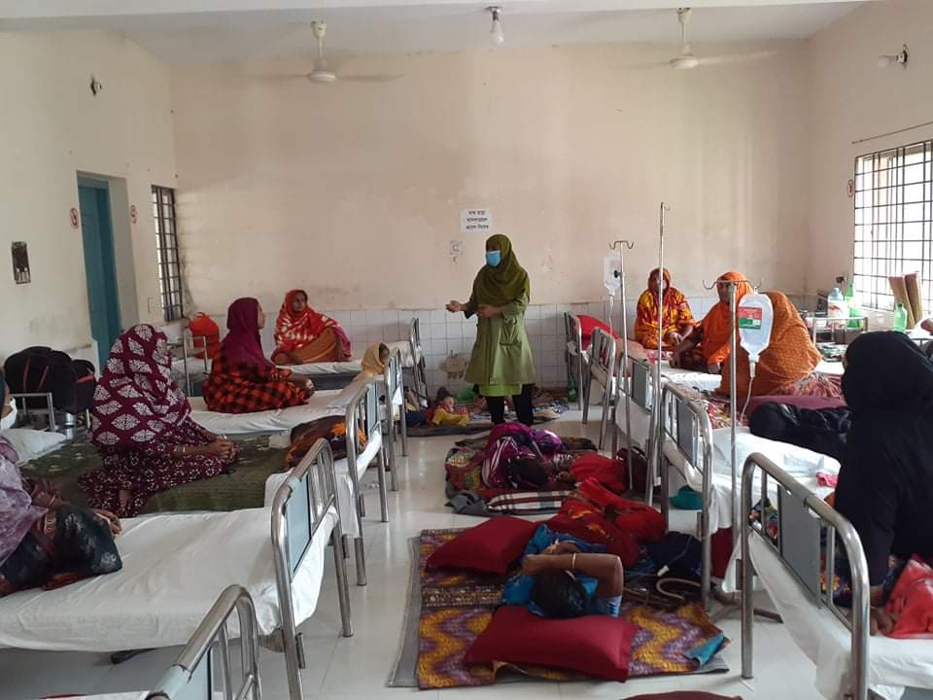
Daily Health Education Session
In front of Emergency Room
In ANC corner
In ANC Waiting room
Indoor

Slide 41


Citizen Charter

Slide 42
Daily Activities

Slide 43
Daily Activities

Slide 44
Daily Activities

Slide 45
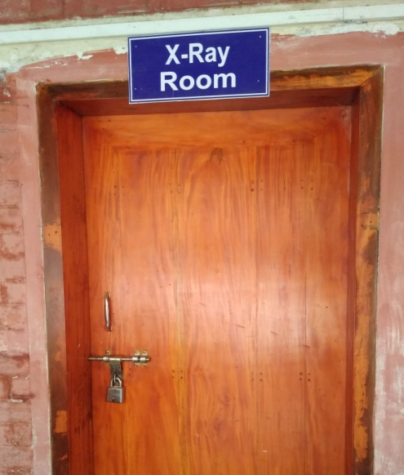
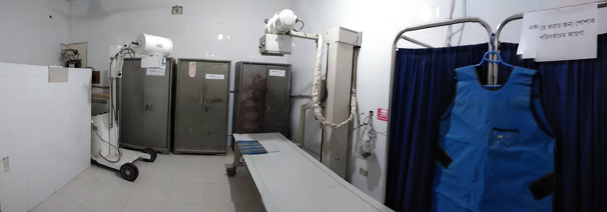
Daily Activities
Radiology Corner

Slide 46


Community Participation
Volunteer working in Reception desk
Ultrasonography machine donated by the Upazila Porishod

Slide 47
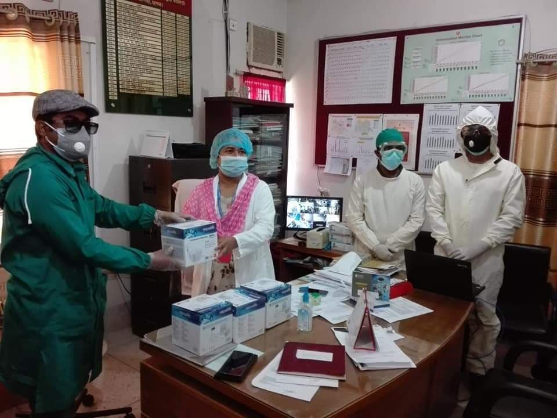
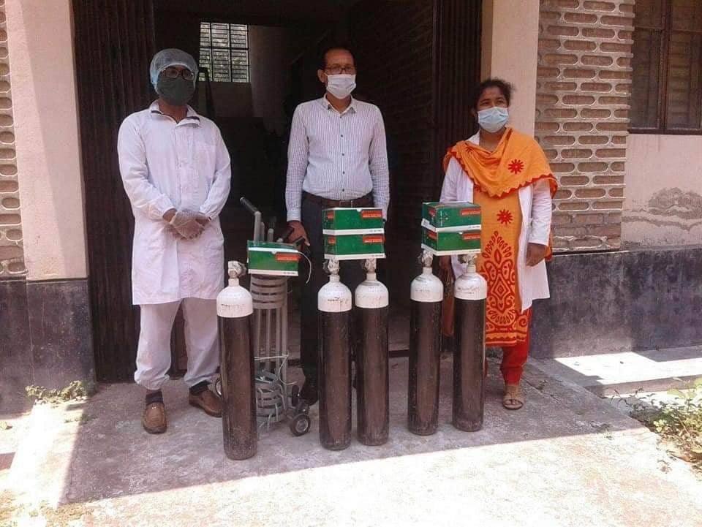
Community Participation
Nebuliser donated to the hospital by Upazila Porishod
Oxygen Cylinders donated by Upazila Porishod

Slide 48
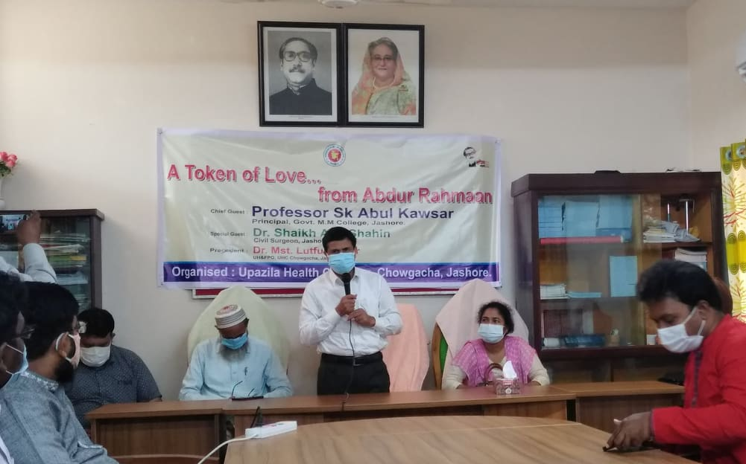
Community Participation
Gift Handover for Kid’s Corner

Slide 49
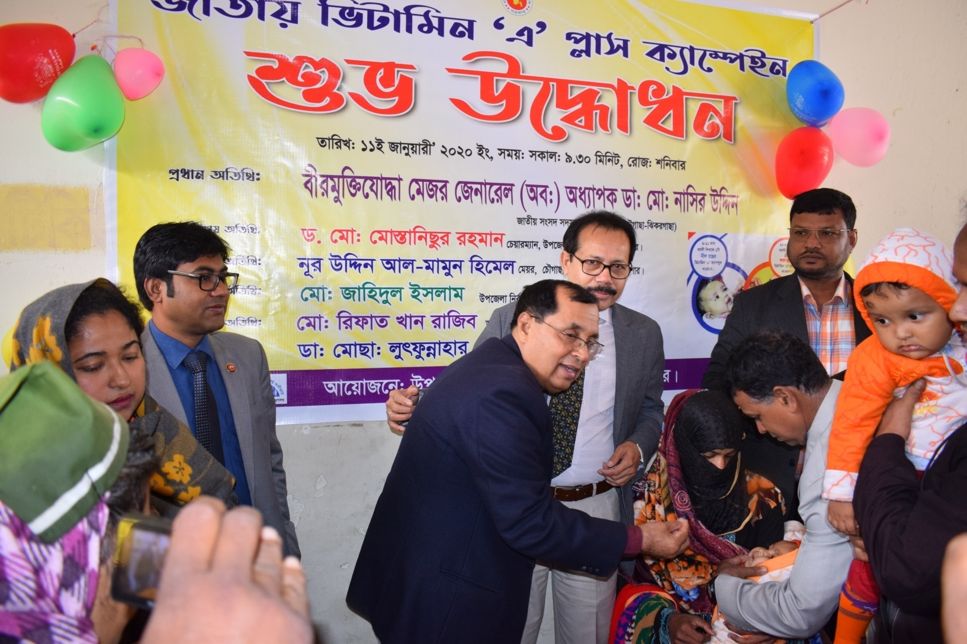
জাতীয় ভিটামিন “এ” প্লাস ক্যাম্পেইন 2020 এর শুভ উদ্বোধন করেন
বীর মুক্তিযোদ্ধা মেজর জেনারেল (অবঃ) অধ্যাপক ডাঃ মোঃ নাসির উদ্দীন এমপি

Slide 50


Visit by Dignitaries – UHC Chowgacha
Honorable Health Minister Prof Dr. Ruhul Haque
MP with WHO Representative handing over
money and gift of voucher scheme of DSF
Secretary of MOHFW A.K.M. Zaforullah Khan
declared “Chowgacha UHC model” in DSF
voucher distribution ceremony on 20 June-2008

Slide 51


Visit by Dignitaries – UHC Chowgacha
Òevsjv‡`‡ki Rb¨ ewnt we‡k¦i
†Kvb g‡W‡ji cÖ‡qvRb †bB|
†PŠMvQv g‡WjB h‡_ó ,
†PŠMvQv ¯^v¯’¨ †mevq `w¶Y
c~e© Gwkqv‡Z GKwU `„óvšÍ ¯’vcb K‡i‡Q|Ó
†PŠMvQv g‡Wj nvmcvZvj cwi`k©bKv‡j
W. gvM©v‡iU P¨vb (gnvcwiPvjK, wek¦ ¯^v¯’¨ ms¯’v)

Slide 52
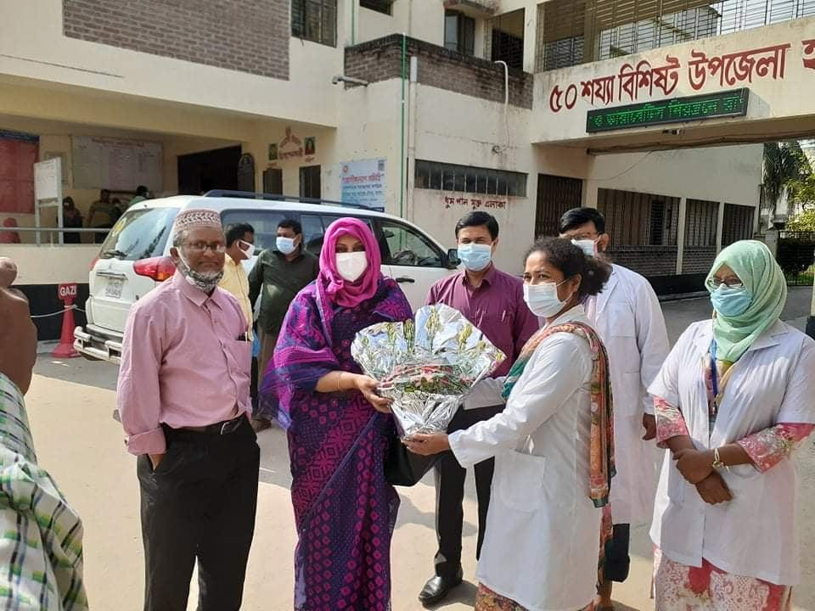
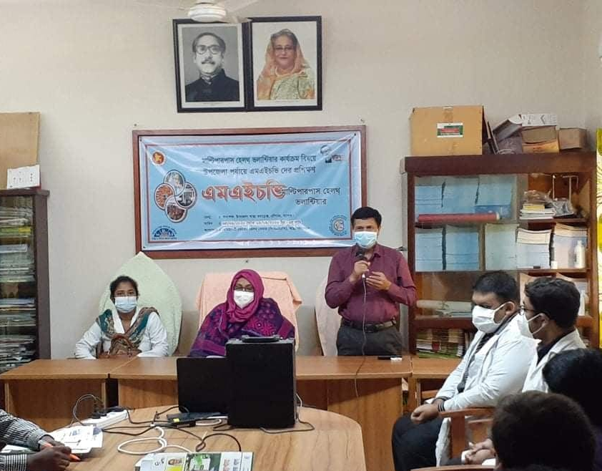
Visit by Dignitaries – UHC Chowgacha
Visit by Honorable DD sir of Khulna Division

Slide 53
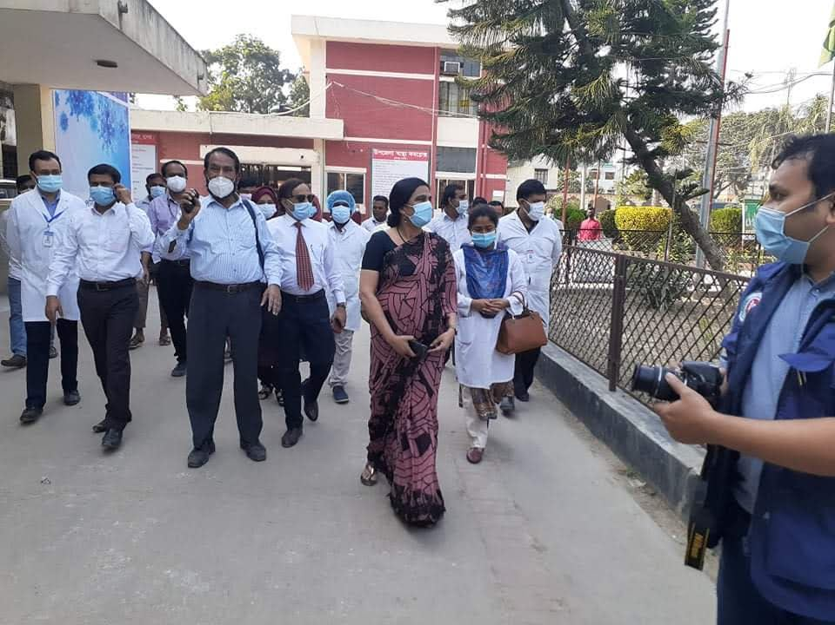
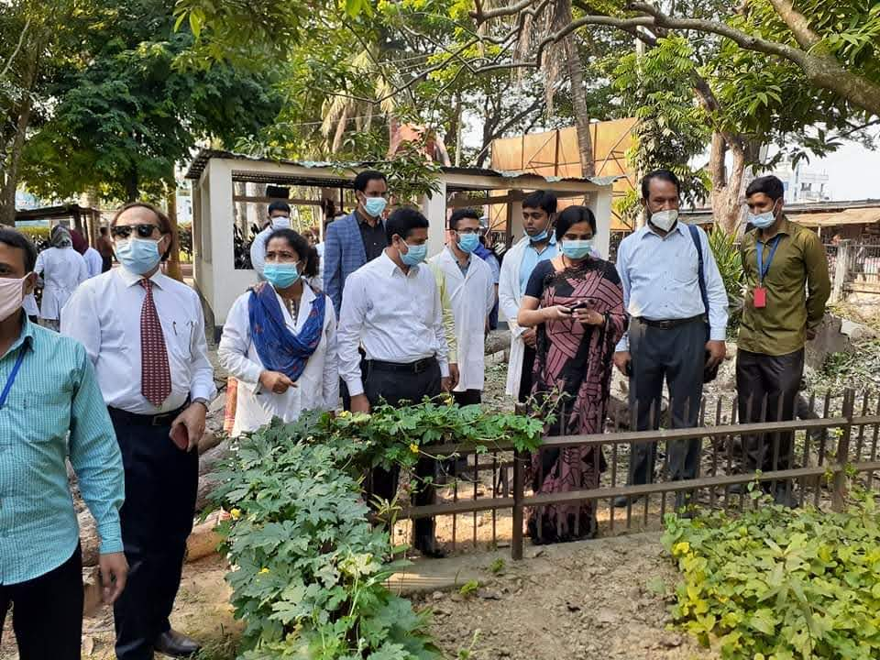
Visit by Dignitaries – UHC Chowgacha
Professor Dr. Meerjady Sabrina Flora visited on 19th Nov 2020
In front of EOC building
In Front of Herbal Garden

Slide 54
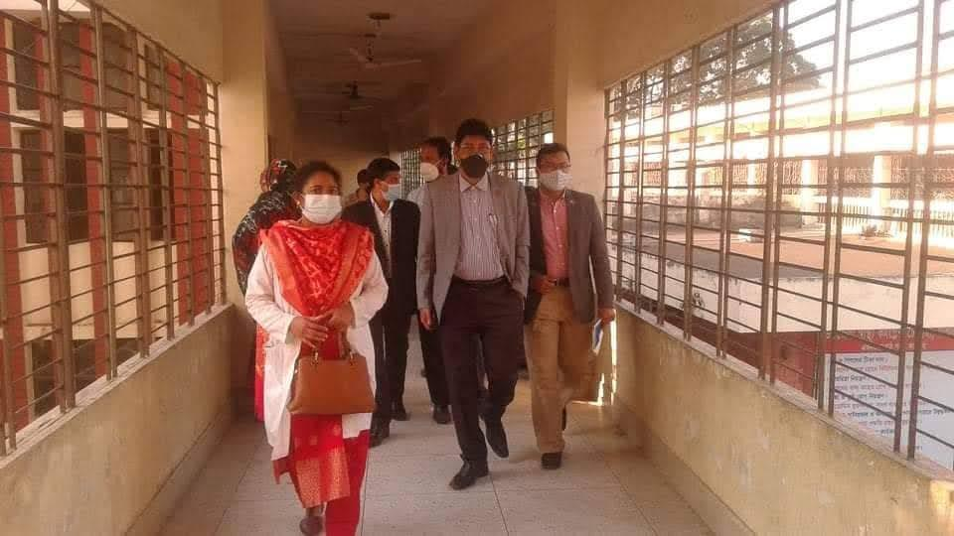
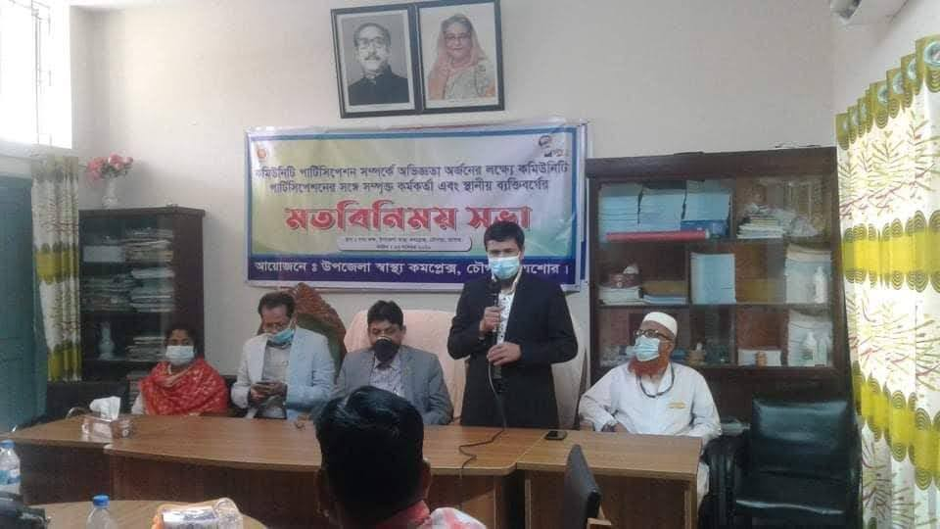
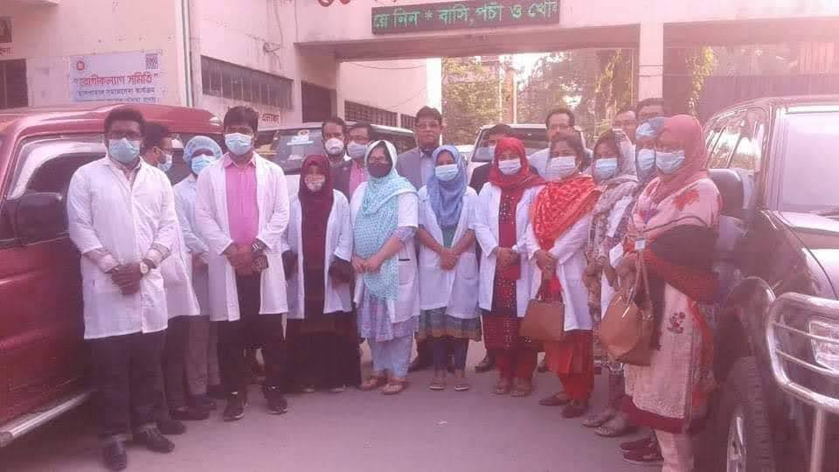
Visit by Dignitaries – UHC Chowgacha
Md. Shahadat Hossain Mahmud, DG (Additional Secretary) Health Economics Unit and his team visited on 23rd Nov 2020

Slide 55


জাতীয় পুষ্টি সপ্তাহ ২০২১
২৩-২৯ এপ্রিল ২০২১
উপজেলা স্বাস্থ্য কমপ্লেক্স, চৌগাছা, যশোর

Slide 56
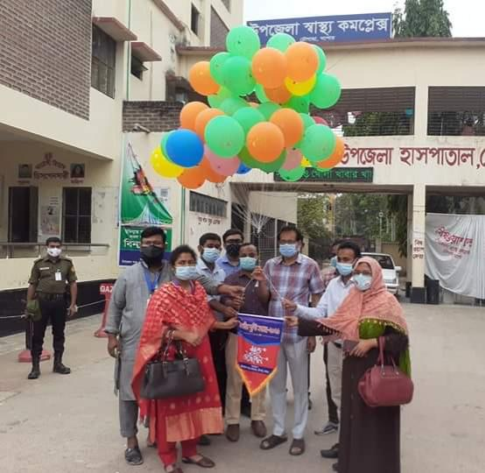
২২/০৪/২০২১
জাতীয় পুষ্টি সপ্তাহ ২০২১ এর
শুভ উদ্বোধন

Slide 57

ACHIEVEMENTS of CHOWGACHA HEALTH COMPLEX
In 2008, Chowgacha Health Complex declared as the Model Upazilla Health Complex
  EOC Beds increased from 11 to 41
  Chowgacha UHC achieved MDG target in 2009
  Chowgacha UHC became the Best EOC center with 98.4% delivery rate in 2011
  Chowgacha Health complex is awarded for best performance in EOC form 2005 to 2014
  Achieve Health Ministers Award for its best performances in 2017 and 2018
  The UHC starts upgrade to 100 bedded hospital
  The UHC model is being replicated throughout the country by MOH & FW and DGHS since 2016 by the order of Prime Ministers office

Slide 58
Challenges
Many of the Health Assistant Posts are vacant
Many consultant posts vacant
Lack of pair of consultant gynaecologist and anaesthetist residing at the hospital premises
Inadequate hospital store
Shortage of ward boy, aya, other 4th class employees and field workers
No separate ward for diarrhoea patients

Slide 59
Way Forward…
Digital Ticketing System and money counter
Online patient database
Separate dinning space for walk-in patients and attendants
Library for the doctors
Regular Academic Sessions for the Doctors and nurses
Day care center for mothers working in this hospital

Slide 60
Recommendations
Budget of health should be increased to support HR and logistics.
Community participation is one of the temporary solution of crisis period.
Arrangements should be done so that health complex run independently
Appointment of all staffs in the vacant posts.
Consultants should be posted in the vacant posts.
Team (Surgeon + Anaesthetist) should reside in the station for round the clock EOC.

Slide 61
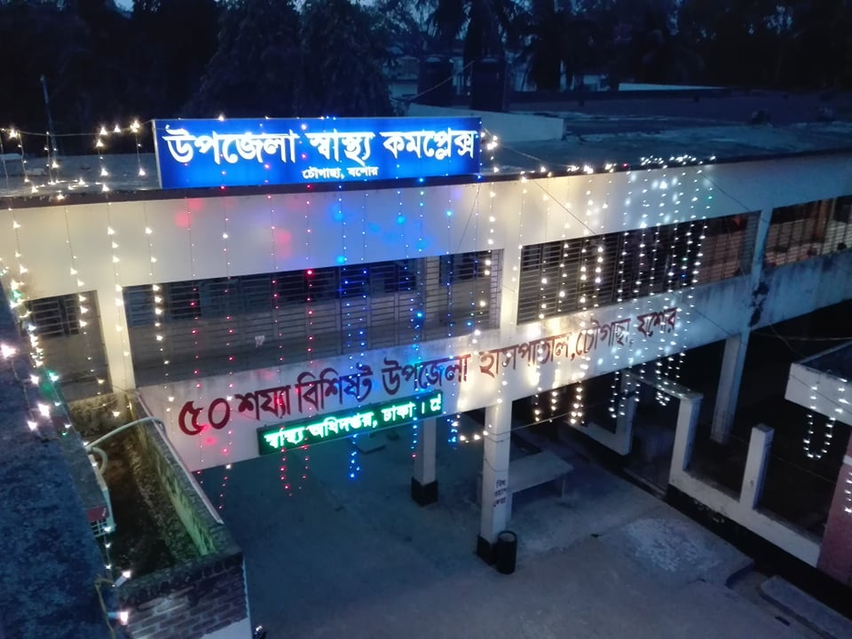
THANK YOU

Slide 62
Total number of NVD performed in different hospitals

